Slide 1

Divided Up
SS.7.C.3.4 Identify the relationship and division of power between the federal government and state government.
The relationship between federal and state governments

Slide 2
How would you describe the picture below?
State/
Regional Government
State/
Regional Government
Central Government
State/
Regional Government
State/
Regional Government
Notes:
Have students explain the picture in the slide. Have them focus on the relationship between the governments (central and state/regional), the flow of the arrows,

Slide 3
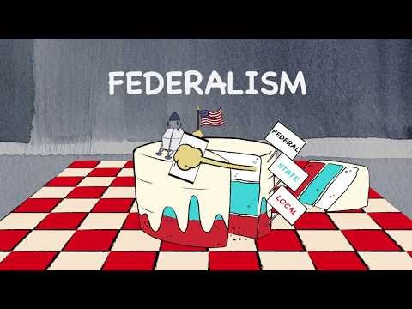
Click the pic for the Federalism Facts of Congress!
(Provided by the Center on Congress)

Slide 4
What is a federal system of government?
Power shared between central and state and local governments
State/
Regional Government
State/
Regional Government
Central Government
State/
Regional Government
State/
Regional Government
Notes:
Emphasize with students that in a federal form of government, the power is shared between the central government and smaller state/regional governments. This means that this system of government is not “centralized” or “decentralized,” but falls somewhere in the middle.

Slide 5
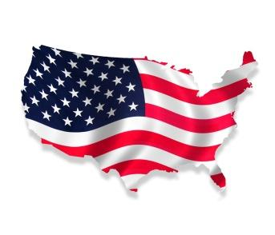
Levels of Government
Government
In our federal system of government, powers, obligations, and services are shared between three levels:
Federal
State
Local

Slide 6

How does a federal system limit government power?
By sharing power, neither the central government or the state/local governments can become too powerful.
Each level of government is given certain powers

Slide 7
How is power distributed in the federal government?
Delegated/
Expressed/
Enumerated Powers
Powers outlined in the U.S. Constitution (example: Powers of Congress in Article I, Section 8)
Reserved Powers
Powers reserved to the States and the People
Concurrent Powers
Powers shared by the State and Federal government

Slide 8
The Hierarchy of Law
The U.S. Constitution is the “Supreme Law of the Land.”
United States Constitution
Acts of
Congress
Even though local, state, and federal government share the power to make laws, it is important to remember that the Constitution, based on Article VI (the “Supremacy Clause”) , is the “Supreme Law of the Land”.
Florida Constitution
State Statutes (laws)
City and County Ordinances

Slide 9
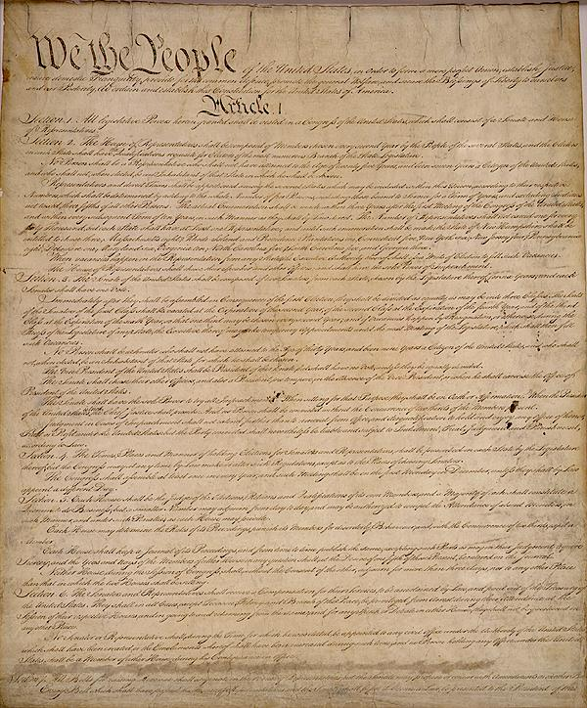
Delegated/Expressed/Enumerated Powers
Powers that are expressly listed/outlined in the United States Constitution
Notes:
Delegated powers and enumerated powers are the powers expressly and specifically granted or assigned in the Constitution. Look in Article One and highlight the powers expressly given to the legislative branch. See Article One, Section 8.

Slide 10
Examples of Delegated/Expressed/Enumerated Powers
Approval of presidential appointments
Naturalization and immigration laws
Armed forces
(Army and Navy)
Sole power to try all impeachments
Declare war
Coin and print money
Regulation of trade
Foreign relations
Notes:
These powers are easily found because they are expressly written and laid out within the U.S. Constitution.

Slide 11

Reserved Powers
Amendment X (10)
The powers not delegated to the United States by the Constitution, nor prohibited by it to the States, are reserved to the States respectively, or to the people.
States
The People
So if the power is not given to the Federal government, nor denied to the states, the power belongs to the State or people.

Slide 12


Some Powers and Responsibilities of State Government
Education
Establishing state courts
Implementing welfare
Setting up local governments
Conducting elections
Maintaining state highways
Issuing marriage licenses
Issuing drivers licenses

Slide 13
Concurrent Powers
Powers that are shared by the Federal and State governments
Can you think of something that would go in the middle?
Taxes
Making laws
Concurrent Powers
Powers Delegated to Federal Government
Powers Reserved for State Government
Notes:
Powers that held by both the federal and state governments such as the ability to levy taxes. State government and federal government can tax people.

Slide 14

Checking for Understanding

